Slide 1

Mambu Training Manual
april 2022

Slide 2
III. Mambu API

Slide 3
III. Mambu API
Integration Model
Mambu API follows a REST architecture allowing resources as accounts, clients, etc., to be viewed, added and modified by a set of HTTP methods.
API Versions
API v1.0
(Current)
API v2.0
(Beta)
Architecture
REST
API documentation can be found on: https://api.mambu.com/#welcome
Methods
GET
PUT
DELETE
POST
PATCH
Cache
Stateless and Cacheable
Response Object
JSON
This guide will show you how to call the APIs using Postman and will cover for v2.0 functionalities and requests.
Postman Free App can be downloaded here: Download Postman | Get Started for Free.

Slide 4
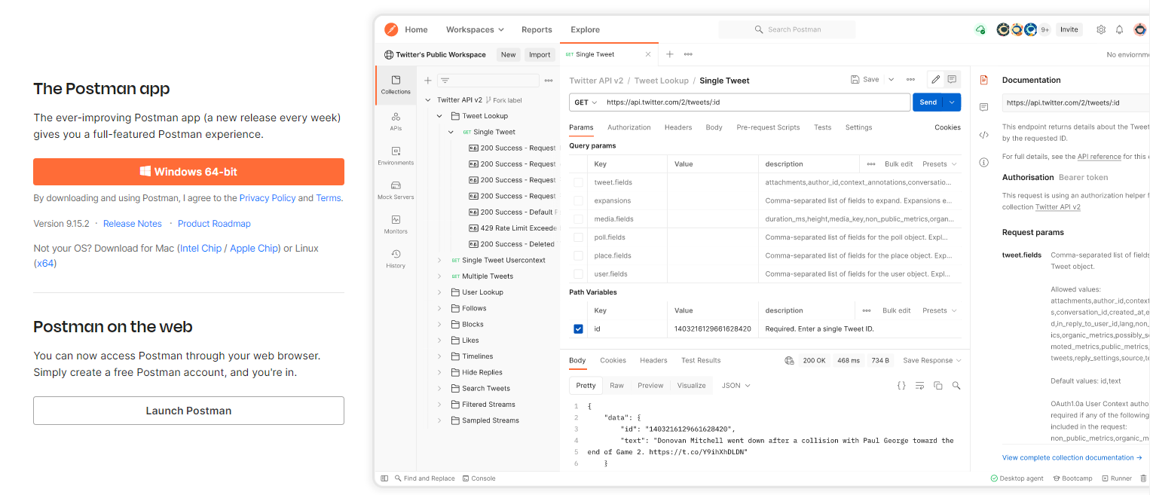
III. Mambu API
Download Postman
Download the app to quickly get started using the Postman API Platform.
Click to download Windowns 64-bit

Slide 5
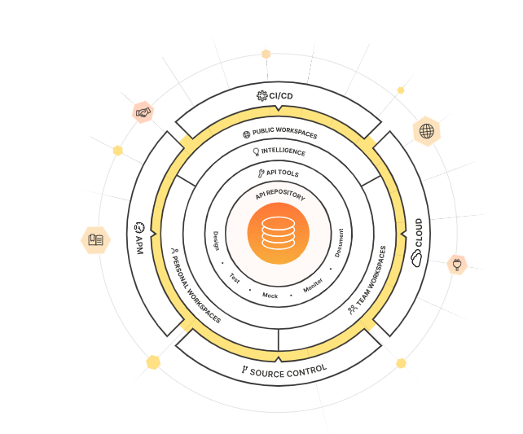
III. Mambu API
Postman Overview
What is Postman?
Postman is an API platform for building and using APIs. Postman simplifies each step of the API lifecycle and streamlines collaboration so you can create better APIs-faster.
API Repository
Easily store, catalog, and collaborate around all your API artifacts on one central platform. Postman can store and manage API specifications, documentation, workflow recipes, test cases and results, metrics, and everything else related to APIs.
Tools
The Postman platform includes a comprehensive set of tools that help accelerate the API lifecycle—from design, testing, documentation, and mocking to the sharing and discoverability of your APIs.
Intelligence
The Postman platform gives you advanced intelligence and insights about all of your API operations by leveraging alerts and security warnings, search, reporting, and more.
Workspaces
Postman workspaces help you organize your API work and collaborate across your organization or across the world. There are three different kinds of Postman workspaces for your different needs: personal workspaces, team workspaces, and public workspaces.
Integrations
Postman integrates with the most important tools in your software development pipeline to enable API-first practices. The Postman platform is also extensible through the Postman API and through open-source technologies.

Slide 6
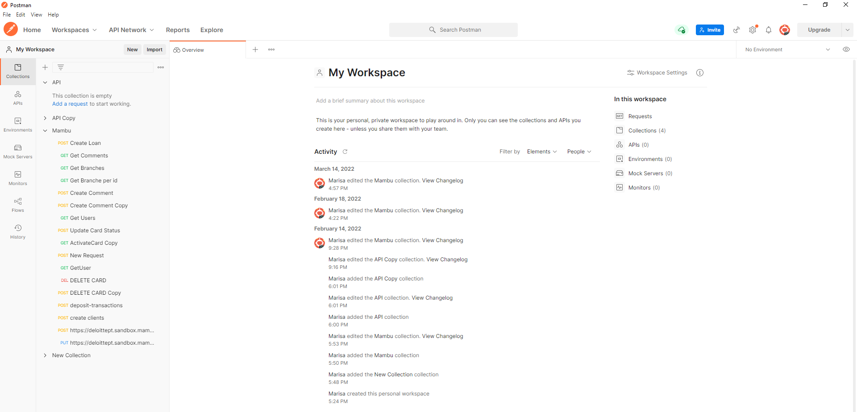
III. Mambu API
Postman Overview
Postman workspaces enable you to organize and work together on API projects with your team. Within each workspace you can share APIs, collections, environments, and other components of your work in Postman.
When you first open Postman, you will be in your default personal workspace. You can create more workspaces for your personal use and to work with teammates. To create more workspaces, you need to sign into your Postman account.
Area of Workspace

Slide 7
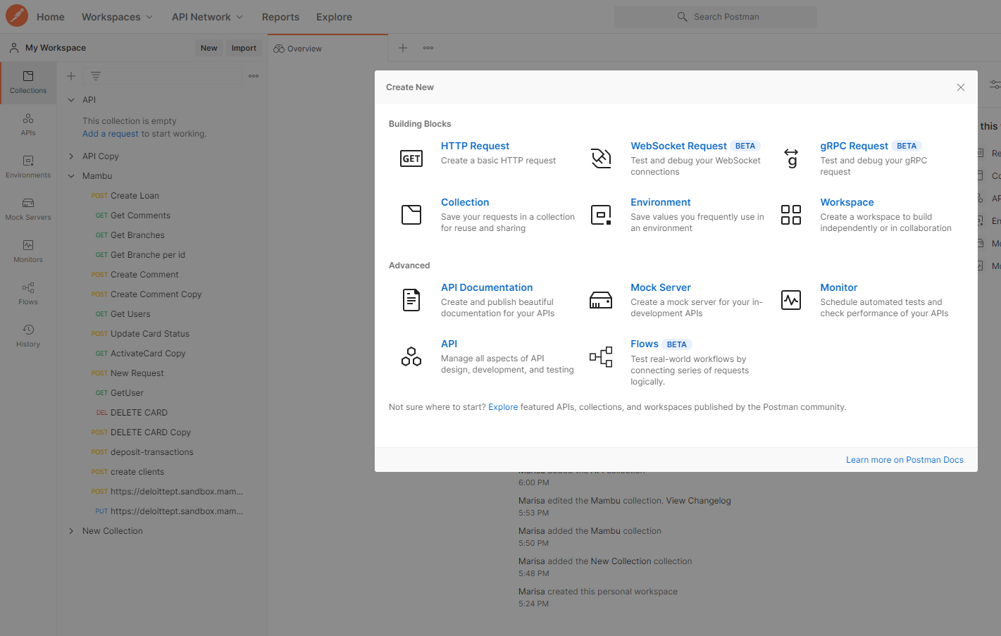

III. Mambu API
Postman Overview: Create a new workspace
Select Workspaces in the upper left. Select Create Workspace to add a new workspace. You can also search for existing workspaces using the search bar or select one from the dropdown list.
Click: Workspace

Slide 8
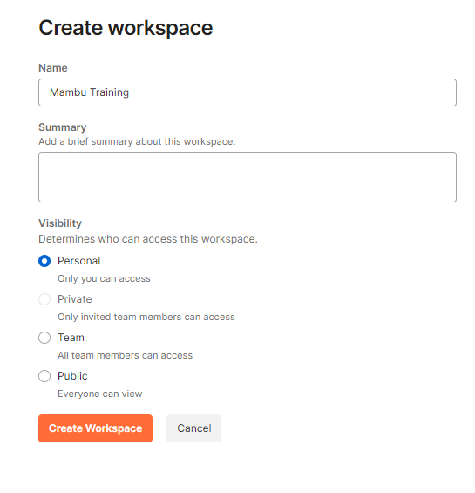
III. Mambu API
Postman Overview: Create a new workspace
Enter a Name and optional Summary for your workspace.
Choose the workspace’s visibility:
A Personal workspace is visible only to you.
A Private workspace is visible to you and to any team members you invite to join it.
A Team workspace is visible to everyone on your team.
A Public workspace is visible to all Postman users.
Note: Postman will switch to your new workspace when you create it. You can move between workspaces at any time by selecting from the dropdown workspaces list in the upper left.
You can start collaborating with other people by inviting them to join your new workspace.
After filling in the fields, click Create Workspace

Slide 9
III. Mambu API
Postman Overview: Create a new collection
Postman Collections are a group of saved requests. Every request you send in Postman appears under the History tab of the sidebar. On a small scale, reusing requests through the history section is convenient. As your Postman usage grows, it can be time-consuming to find a particular request in your history. Instead of scrolling through your history section, you can save all your requests as a group for easier access.
Select Collection in the upper left.
Click: Collection

Slide 10

III. Mambu API
Postman Overview: Building requests
You can send requests in Postman to connect to APIs you are working with. Your requests can retrieve, add, delete and update data, Whether you are building or testing your own API, or integrating with a third-party API, you can try out your requests in Postman. Your requests can send parameters, authorization details, and any body data you require.
Example: If you’re building a client application (such as a mobile or web app) for a store, you might send one request to retrieve the list of available products, another request to create a new order (including the selected product details), and a different request to log a customer in to their account.
When you send a request, Postman displays the response received from the API server in a way that lets you examine, visualize, and if necessary, troubleshoot it.

Slide 11
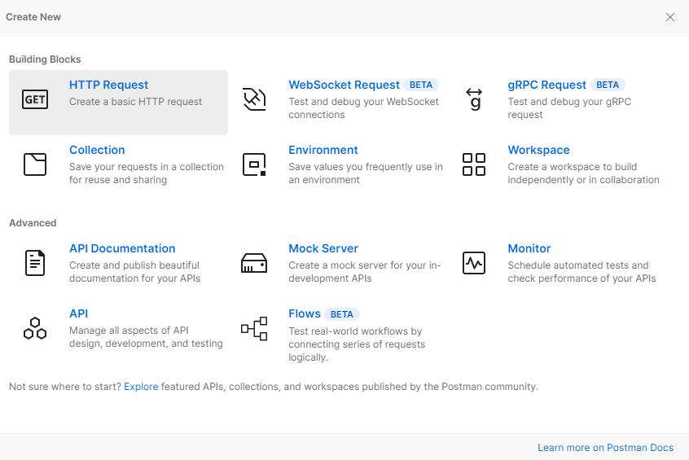
III. Mambu API
Postman Overview: Creating requests
Your requests can include multiple details determining the data Postman will send to the API you are working with. Enter a URL and choose a method, then optionally specify a variety of other details.
You can create a new request from the Postman home screen, by using New > HTTP Request, or by selecting the + button to open a new tab.
Select Save to create your request. You can give your request a name and description, and choose or create a collection to save it in.
Once your new tab is open, you can specify the details you need for your request.
Click: HTTP Request to create a request

Slide 12
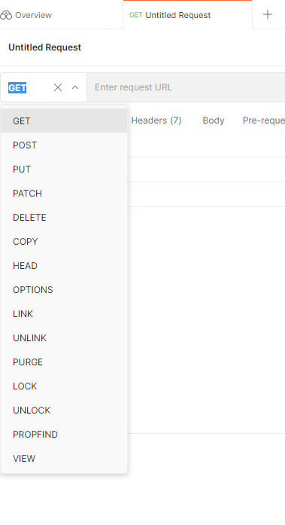
III. Mambu API
Postman Overview: Selecting request methods
By default, Postman will select the GET method for new request. Get methods are typically for retrieving data from an API. You can use a variety of other methods to send data to your APIs, including the following most common options:
Post – add new data
Put – replace existing data
Patch - Update some existing data fields
Delete - delete existing data
Note: PUT Request (Update) is a resource modification method where the client sends all the data that make up the resource, which in turn updates the entire resource. While , PATCH does a partial update, for example. Fields that need to be updated by the customer, only this field is updated without modifying the other field.
Example:
If you’re working with an API for a TO DO list application, you might use a GET method to retrieve the current list of task, a Post method to create a new task, and PUT or PATCH method to edit an existing task.
Postman supports a number of additional request methods by default, and you can use custom methods. Select the method dropdown list, edit the method name text, and save your new method. To delete a method, hover over it in the list and select the trash icon.

Slide 13
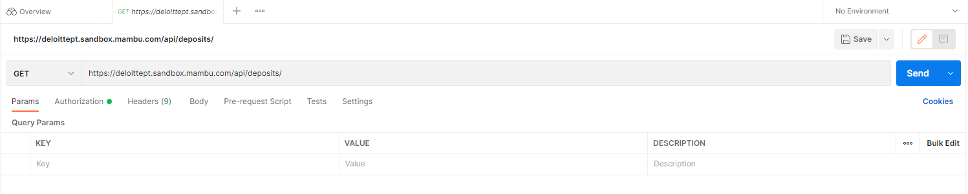
III. Mambu API
Postman Overview: Sending parameters
You can send path and query parameters with your requests using the URL field and the Params tab.
To send a query parameter, add it directly to the URL or open Params and enter the name and value. You can enter your query parameters in either the URL or UI fields and value. You can enter a path parameter, Postman will populate it in the Params tab, where you can also edit it.
Enter the API you want to execute

Slide 14
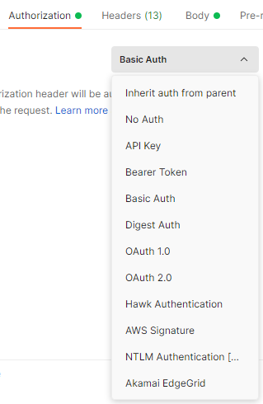
III. Mambu API
Postman Overview: Authorization configuration
APIs use authorization to ensure that client requests access data securely. This can involve authenticating the sender of a request and verifying that they have permission to access or manipulate the relevant data. If you're building an API, you can choose from a variety of auth models. If you're integrating a third-party API, the required authorization will be specified by the API provider.
You can pass auth details along with any request you send in Postman. Auth data can be included in the header, body, or as parameters to a request. If you enter your auth details in the Authorization tab, Postman will automatically populate the relevant parts of the request for your chosen auth type. You can use variables and collections to define authorization details more safely and efficiently, enabling you to reuse the same information in multiple places.
Select a type from the Type dropdown list on the Authorization tab. You can choose an authorization type on requests, collections, or folders.
Note: The types of authorization most used in a project context are: Basic Auth and API Key.
Types of Authorization

Slide 15
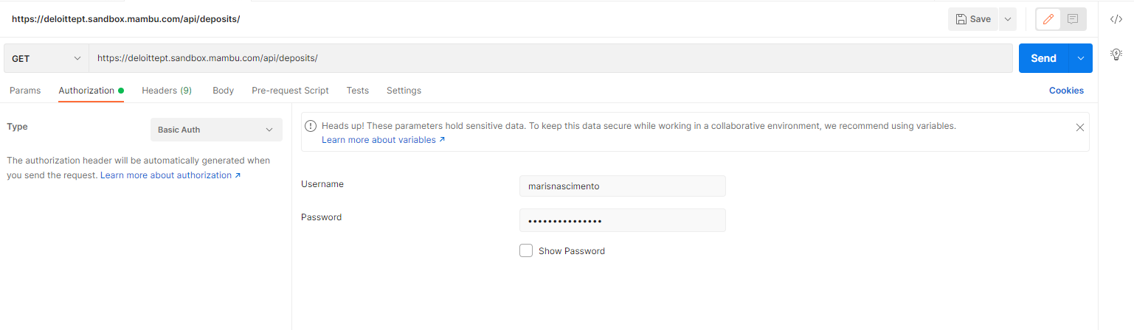
III. Mambu API
Postman Overview: Authorization configuration
In the request Authorization tab, select Basic Auth from the Type dropdown list.
Basic authentication involves sending a verified username and password with your request.
Note: After successfully entering the credentials, a green light will automatically appear.
Is connected
Select the type: Basic Auth
Note: The username and password are the same as in the sandbox

Slide 16
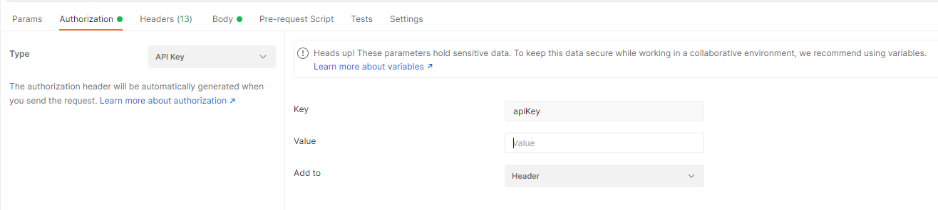
III. Mambu API
Postman Overview: Authorization configuration
In the request Authorization tab, select API Key from the Type dropdown list.
With API key auth, you send a key-value pair to the API either in the request headers or query parameters. In the request Authorization tab, select API Key from the Type list. Enter your key name and value and select either Header or Query Params from the Add to dropdown list. You can store your values in variables for additional security.
Note: After successfully entering the credentials, a green light will automatically appear.
Select the type: API Key
Note: The value must be obtained in the Mambu sandbox

Slide 17
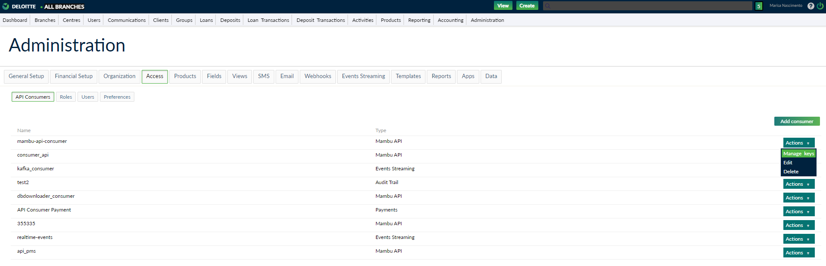
III. Mambu API
Postman Overview: Authorization configuration
How to get access value via API KEY ?
In the Mambu Sandbox, go to the Admin tab > Access > API Consumers.
In the values list appear, select the Actions buttons to : mambu-api-consumer, and select the option Manage Keys option.
Note: The values shown are merely illustrative.

Slide 18
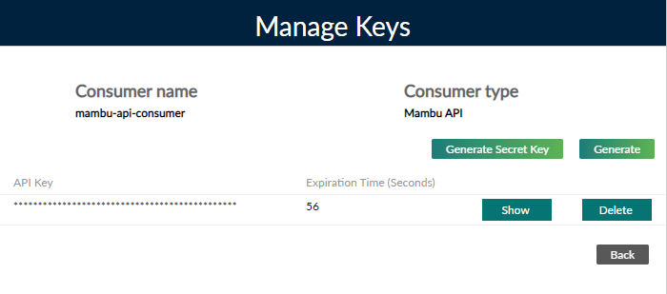
III. Mambu API
Postman Overview: Authorization configuration
In the Manage keys preview window, click show, to see the access value.
Select to generate a new value with not expiration time.
Value of API Key
Note: Select Show to copy the value
Please Be Aware
Your Mambu credentials are used to access and modify your account and information. It is important to securely store your credentials in order to prevent unauthorized access.
Never send your credentials over unencrypted email or chat, post them to a help forum, or store them in a repository.

Slide 19
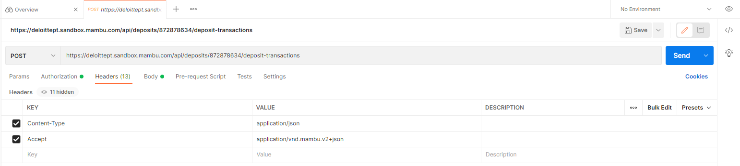
III. Mambu API
Postman Overview: Headers configuration
Some APIs require you to send particular headers along with requests, typically to provide additional metadata about the operation you are performing. You can set these up in the Headers tab. Enter any key-value pairs you need and Postman will send them along with your request. As you type, Postman will prompt you with common options you can use to autocomplete your setup, such as Content-Type.
Note: When connecting to the Mambu sandbox, it is necessary to fill in the following field:
Key: Accept Value: application/vnd.mambu.v2+json
In some cases, it is necessary to put the following parameter
Key: Content-Type Value: application/json
Select the checkbox to enable each of the headers

Slide 20
III. Mambu API
Postman Overview: Body configuration
You will need to send body data with requests whenever you need to add or update stuctured data. For exemple, if you’re sending a request to add a new customer to a database, you might include the customer details in JSON. Typically, you will use body data with PUT, POST and PATCH requests.
The body tab in Postman allows you to specify the data you need to send with a request. You can send various different types of body data to suit your API.
Note: If you're sending body data, make sure you have the correct headers selected to indicate the content type your API may need to process the received data correctly.
By default, Postman will select None—leave it selected if you don't need to send a body with your request. In this case, you must select raw data and then JSON.
Notes:
You can use raw body data to send anything you can enter as text. Use the raw tab, and the type dropdown list to indicate the format of your data (Text, JavaScript, JSON, HTML, or XML) and Postman will enable syntax-highlighting as well as appending the relevant headers to your request.

Slide 21
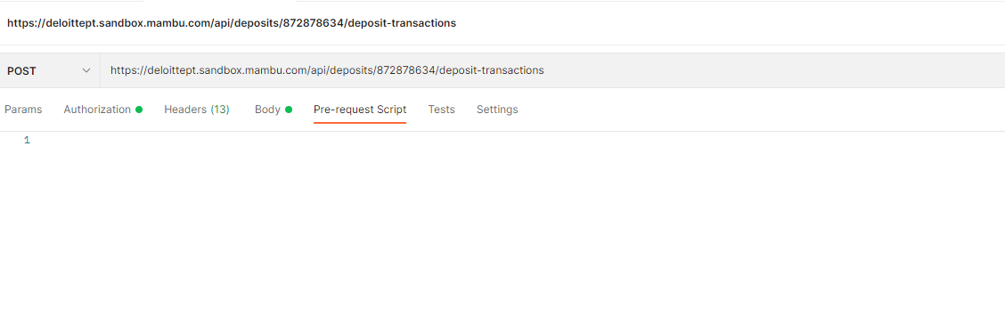
III. Mambu API
Postman Overview: Pre-request script
You can use pre-request scripts in Postman to execute JavaScript before a request runs. By including code in the Pre-request Script tab for a request, collection, or folder, you can carry out pre-processing such as setting variable values, parameters, headers, and body data. You can also use pre-request scripts for debugging code, for example by logging output to the console.
An example usage of pre-request scripting could be as follows:
You have a series of requests in a collection and are running them in a sequence, e.g. using the collection runner.
The second request is dependent on a value returned from the first request.
The value needs to be processed before you pass it to the second request.
The first request sets the data value from a response field to a variable in its Tests script.
The second request retrieves the value and processes it in its Pre-request Script, then sets the processed value to a variable (which is referenced in the second request, e.g. in its parameters).
Area of Pre-request Script

Slide 22
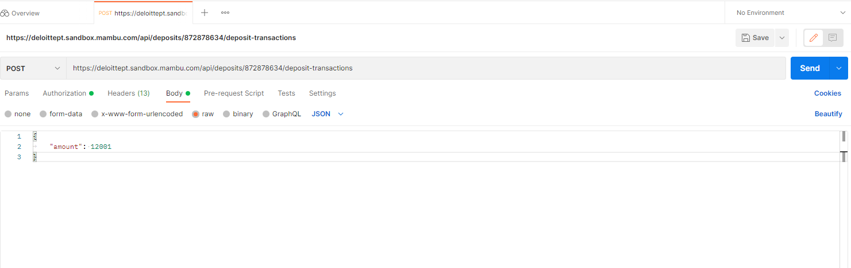
III. Mambu API
Postman Overview: Body configuration
Below you can see an example of a body, in case you have any doubts about the mandatory parameters to be sent through the body. See page Mambu API v2 Reference Page and look for the parameters needed for the API you want to test.
Area of Body
Example of parameters

Slide 23
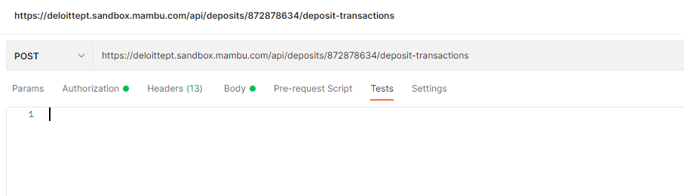
III. Mambu API
Postman Overview: Tests
Tests verify that your API is working as expected, that integrations between services are functioning reliably, and that new developments haven't broken any existing functionality. You can write test scripts for your Postman API requests in JavaScript. You can also use test code to aid the debugging process when something goes wrong with your API project. For example, you might write a test to validate your API's error handling by sending a request with incomplete data or incorrect parameters.
You can add tests to individual requests, collections, and folders in a collection. Postman includes code snippets you add and then modify to suit your test logic.
Area of tests

Slide 24
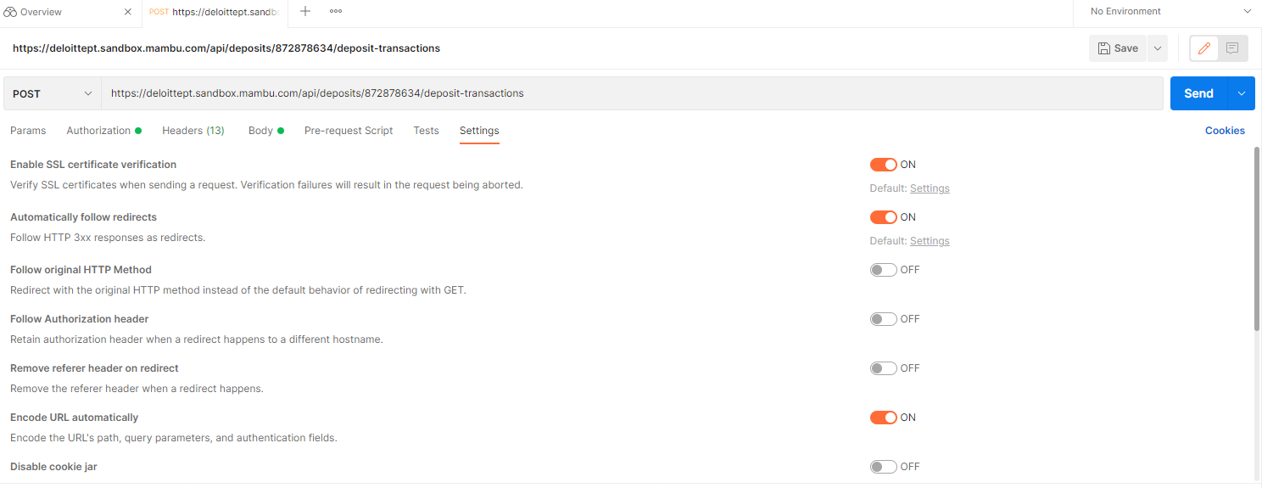
III. Mambu API
Postman Overview: Choosing custom settings
You can configure a variety of settings for Postman requests using the request Settings tab. These allow you to apply non-standard logic to your requests.
Area of settings

Slide 25
III. Mambu API
Postman Overview: Send the request
Once you have your request set up, select Send and examine the Response.
Click Send to execute the request

Slide 26
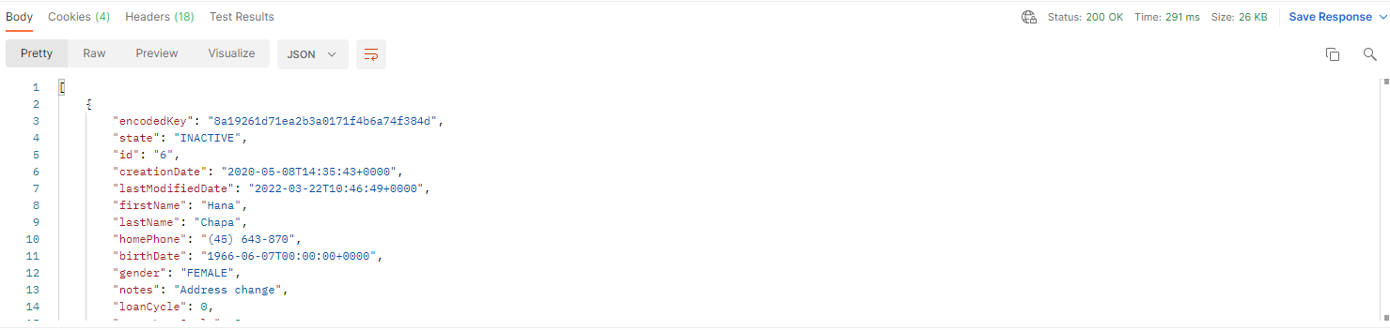
III. Mambu API
Postman Overview: Receiving responses
The Postman response viewer helps you to visualize and verify the correctness of API responses. An API response consists of the response body, headers, and the HTTP status code.
Response body
The Postman Body tab gives you several tools to help you understand the response quickly. You can view the body in one of four views: Pretty, Raw, Preview, and Visualize.
Note: In this case the most important view is the pretty.
Area of status response
Area of response body

Slide 27
III. Mambu API
Postman Overview: Responses
The response to a request will always be in JSON format and will contain either:
An error response consisting of:
Field | Type | Availability | Content
errorCode | number | Always present | A unique error code. For a full list, please see Mambu Response Codes (API Response & Error Codes - APIs (mambu.com)).
errorSource | string | Sometimes present | A human-readable message capturing unsatisfied constraints.
errorReason | string | Always present | A human-readable message stating the general category of the failure.

Slide 28
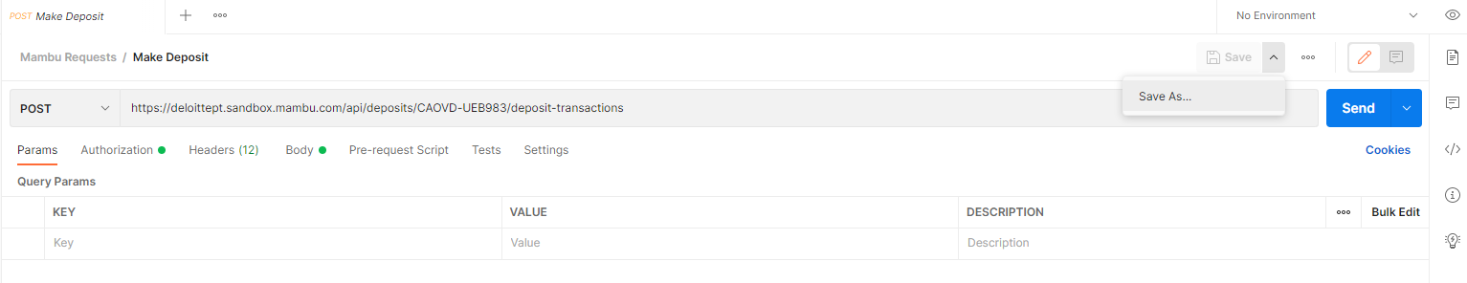
III. Mambu API
Postman Overview: Save Request in collection
In order to keep requests organized, we recommend saving requests to collections. To do this, click Save as.
Click Save as

Slide 29
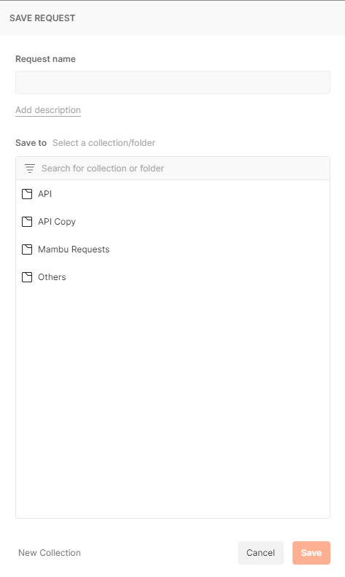
III. Mambu API
Postman Overview: Save Request in collection
In the "Save Request" window, fill in the name of the request and select the desired collection for your request to be saved.
Note: If you don't have any collections created yet, you can create them from here.
Enter a name for your request
Save in the created collection
Click to create a new collection
Click to save the request

Slide 30
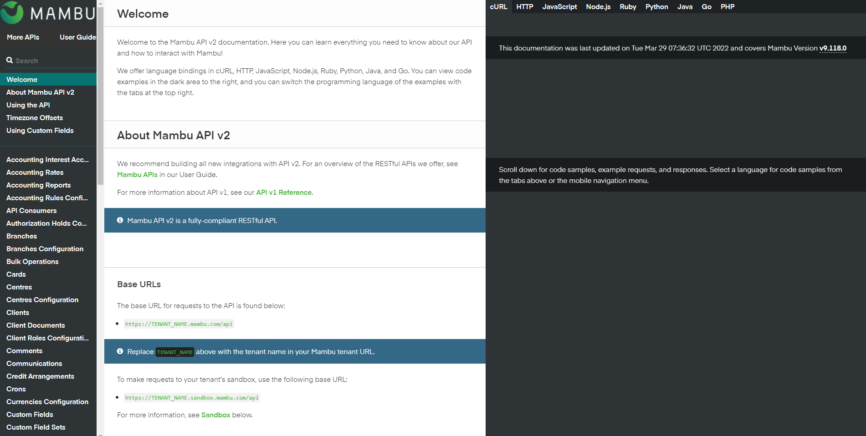
III. Mambu API
Mapping between Reference Page and Postman
As stated at the beginning of the section, the Reference page is the page where you can find all the information needed to run an API in Postman.
Note: There is information presented on the Reference Page that is not updated.
Link to Reference Page: Welcome – Mambu API v2 Reference Page
Reference Page

Slide 31
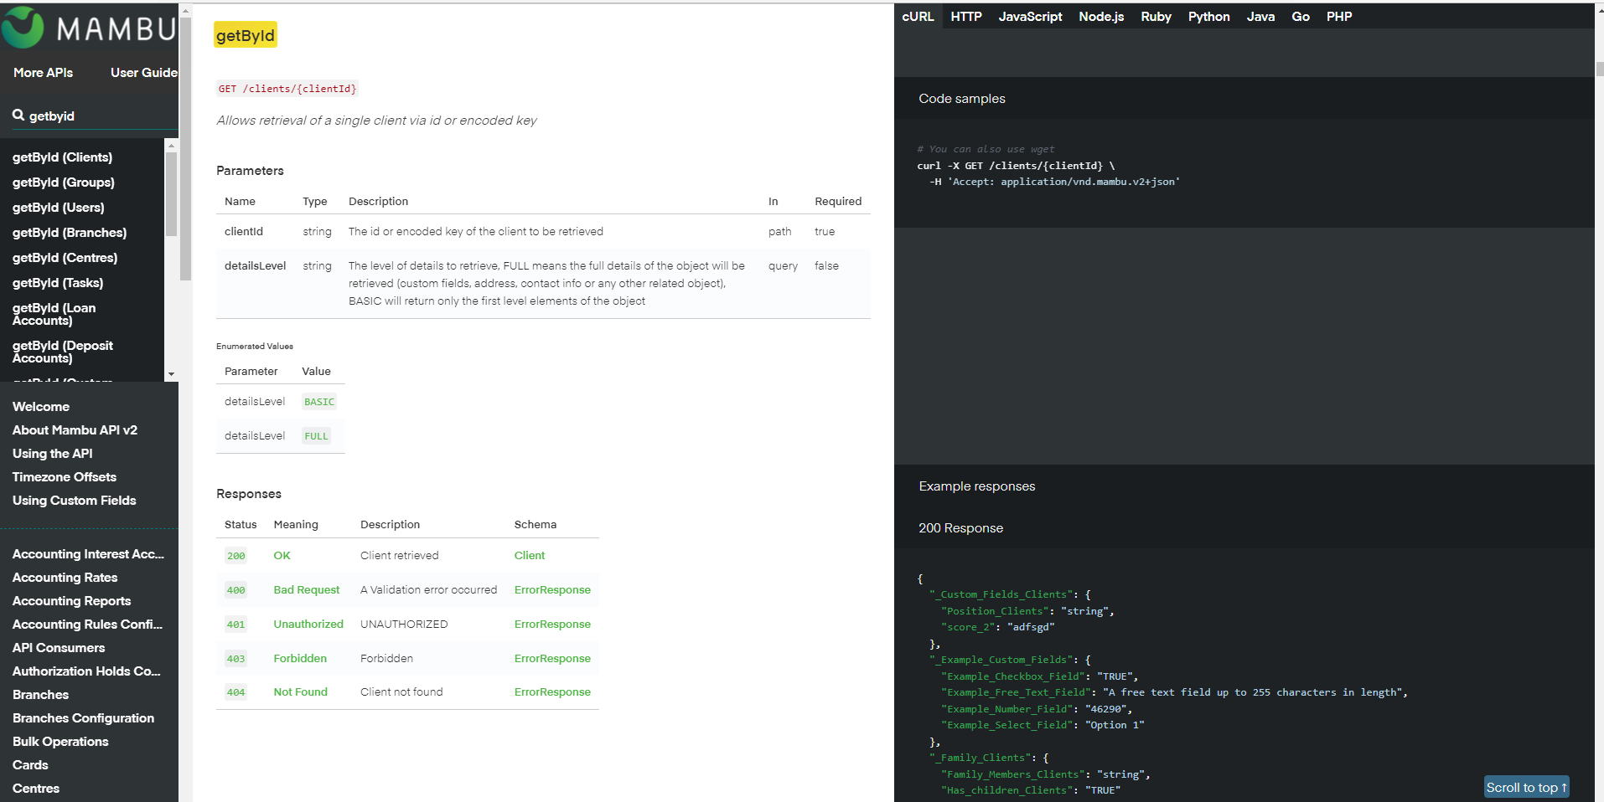
III. Mambu API
Mapping between Reference Page and Postman
Search area
Area of Headers configuration in Postman
Area of Status Response
Area of Response body in Postman

Slide 32
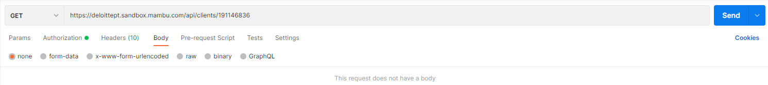
III. Mambu API
Mapping between Reference Page and Postman
Reference Page
Postman

Slide 33
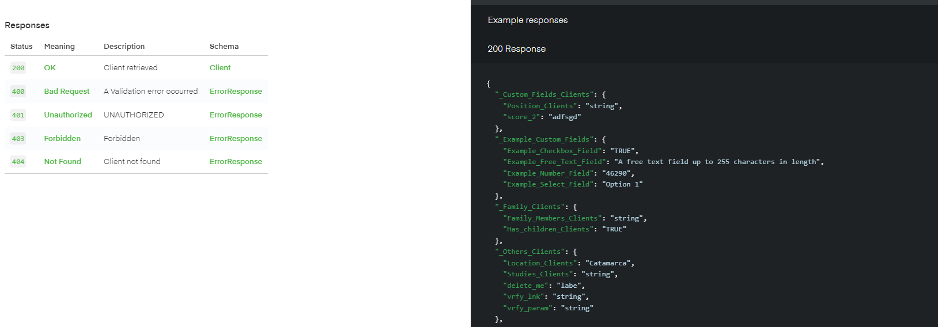
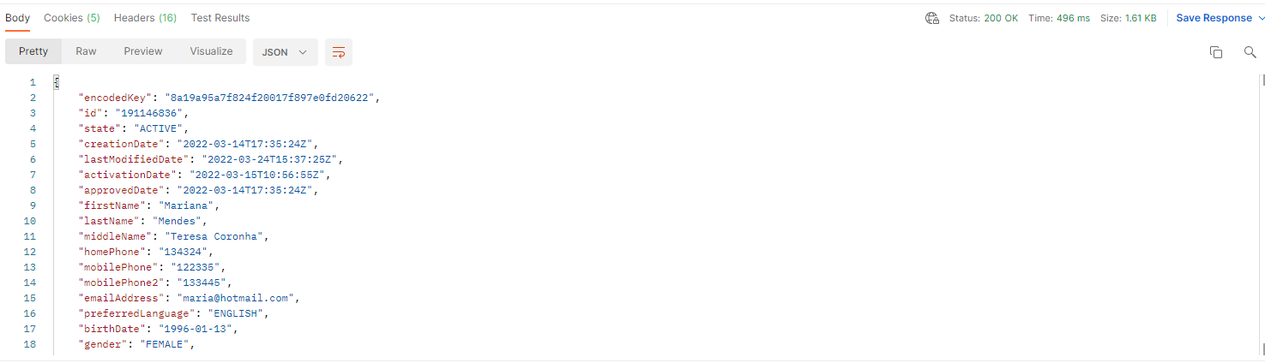
III. Mambu API
Mapping between Reference Page and Postman
Reference Page
Reference Page
Postman

Slide 34
III. Mambu API
Self-Guided Tutorials
1. Get all clients
2. Get all loans
3. Get Loan by ID
4. Make Deposit
5. Create Client
6. Delete Client
7. Update Client
8. Patch Client
9. Search Client
Note: Click here to access the collection with the exercises.

Slide 35
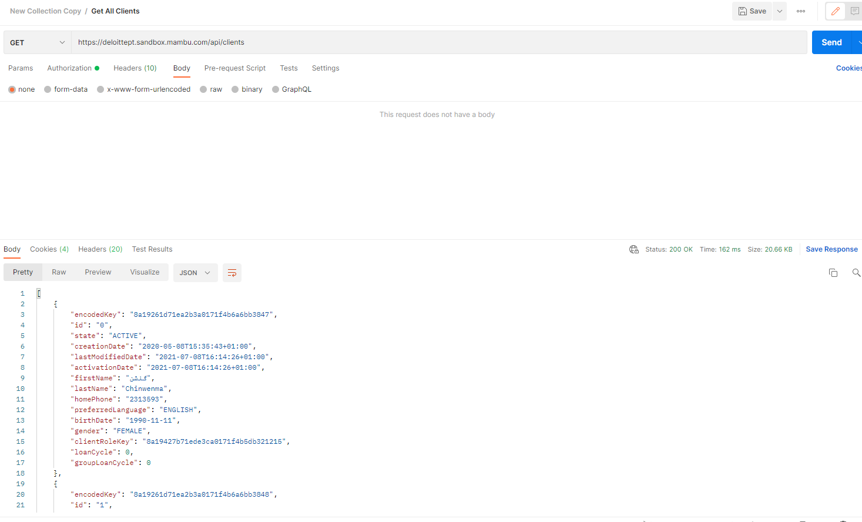
III. Mambu API
Self-Guided Tutorials
GET all clients
Assumptions:
Valid user;
Valid API.
API related to Get all clients
Request
Response

Slide 36
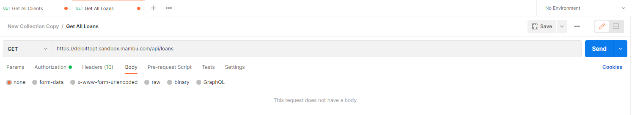
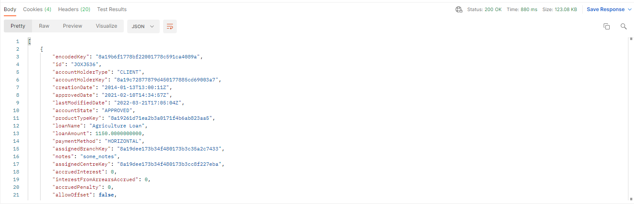
III. Mambu API
Self-Guided Tutorials
2. GET all loans
Assumptions:
Valid user;
Valid API.
API related to Get all loans
Request
Response

Slide 37
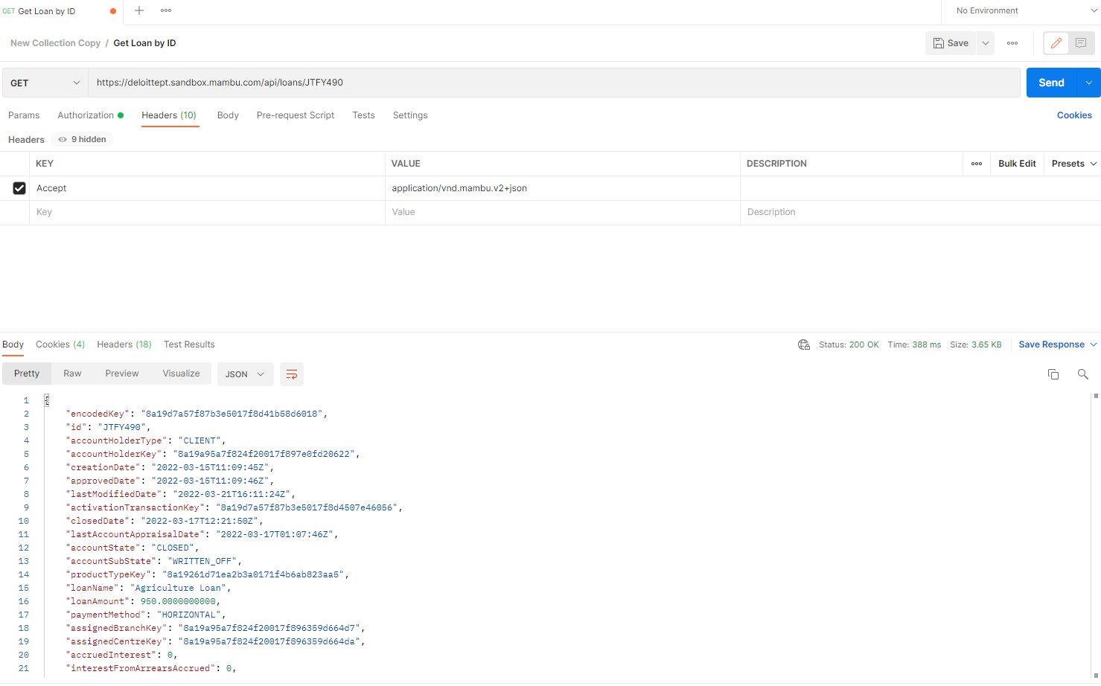
III. Mambu API
Self-Guided Tutorials
3. GET loan by ID
Assumptions:
Valid user;
Valid API;
Valid loan ID.
API related to Get loan by ID
Note: Loan ID I want to get
Request
Response

Slide 38
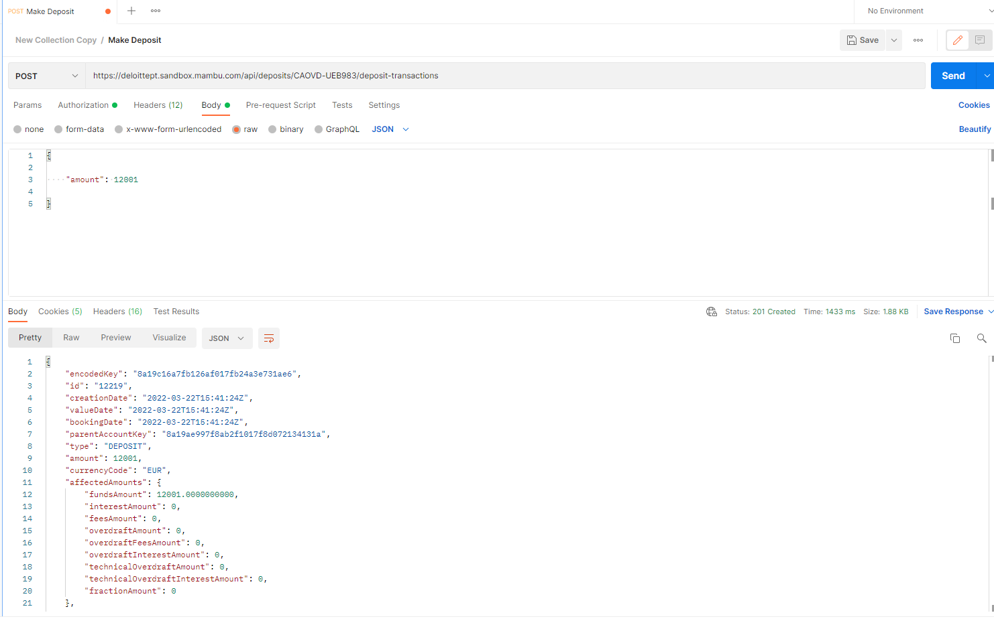
III. Mambu API
Self-Guided Tutorials
4. POST Make Deposit
Assumptions:
Valid user;
Valid API;
Valid ID deposit account.
API related to Make Deposit
Note: ID deposit account
Request
Response

Slide 39
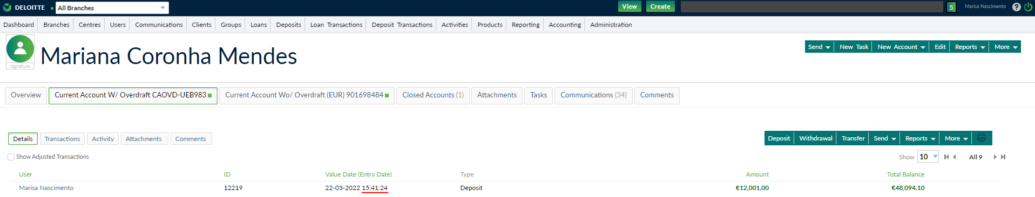
III. Mambu API
Self-Guided Tutorials
4.1 Transaction validation in sandbox.

Slide 40
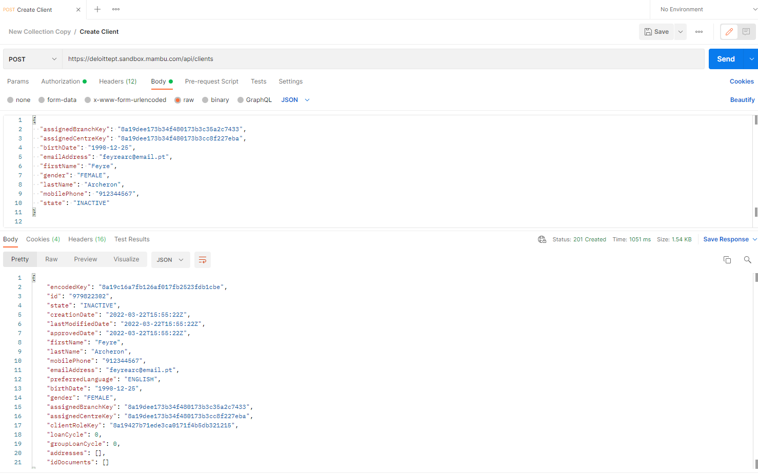
III. Mambu API
Self-Guided Tutorials
5. POST Create client
Assumptions:
Valid user;
Valid API;
All fields shown in the body.
API related to create client
Request
Body
Response

Slide 41
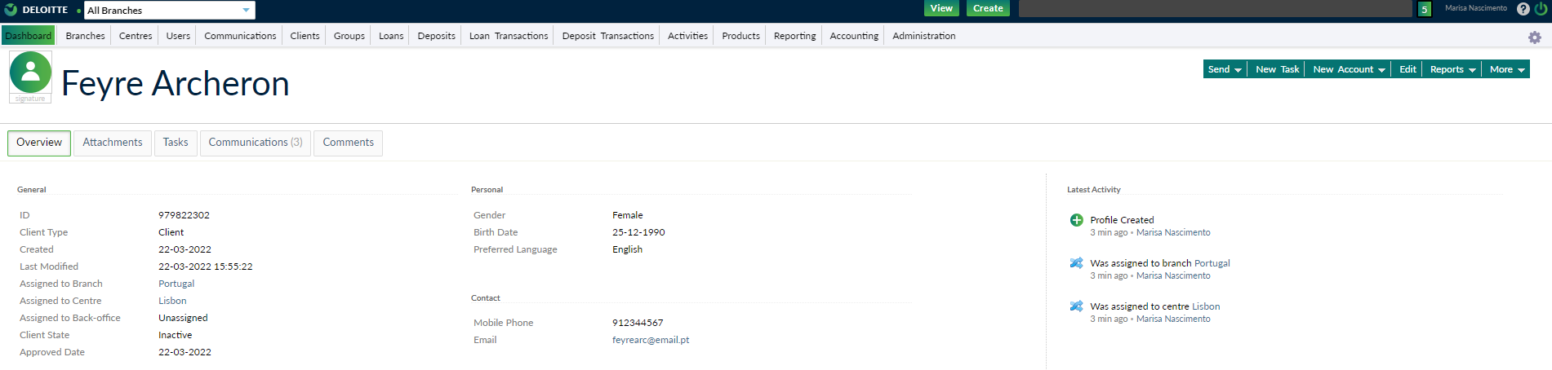
III. Mambu API
Self-Guided Tutorials
5.1 Validation of client creation in sandbox.

Slide 42
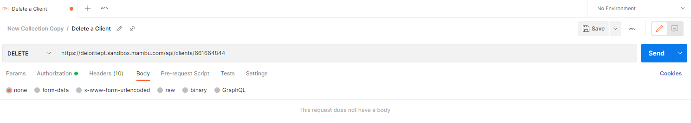
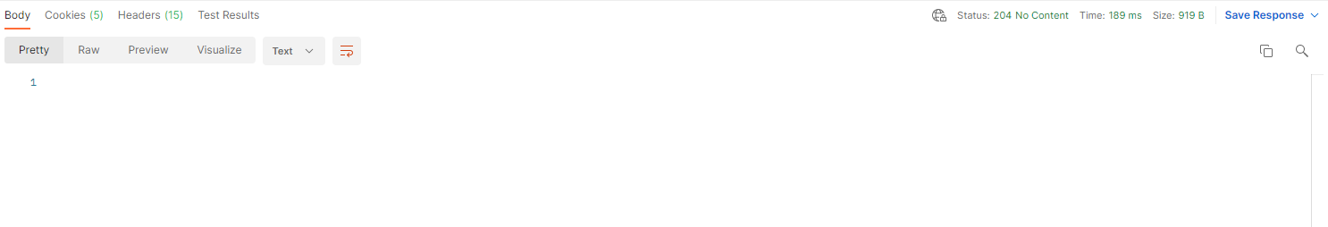
III. Mambu API
Self-Guided Tutorials
6. Delete Client
Assumptions:
Valid user;
Valid API;
Client id available to be deleted.
API related to delete client
Note: ID client to delete
Request
Response

Slide 43
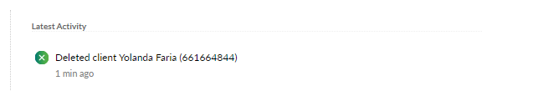
III. Mambu API
Self-Guided Tutorials
6.1 Validation of client deletion in sandbox.

Slide 44
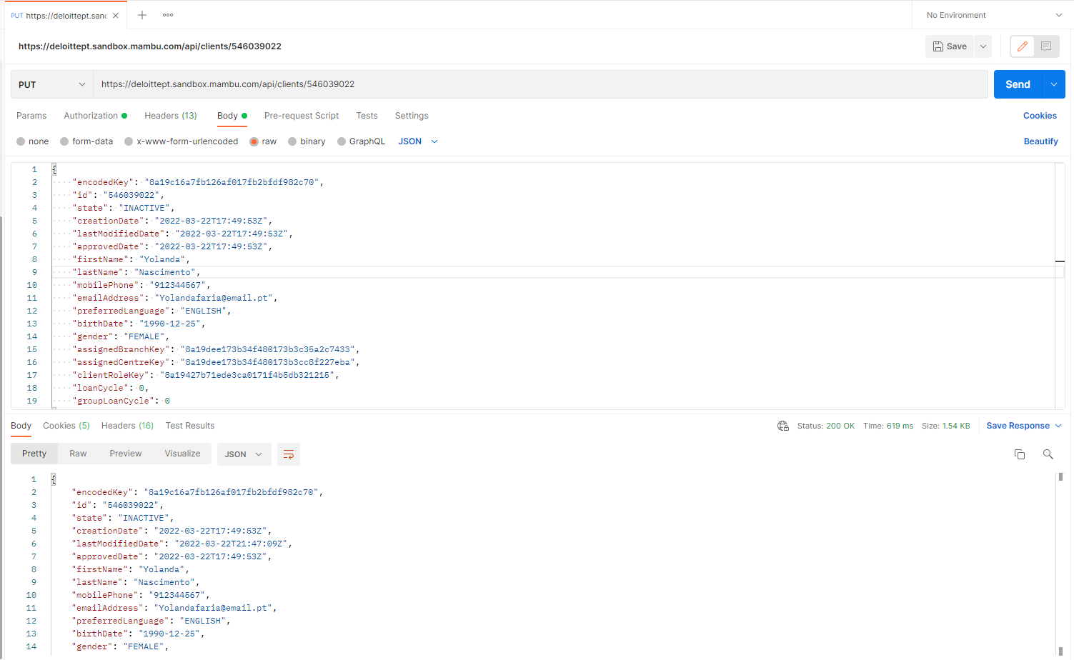
III. Mambu API
Self-Guided Tutorials
7. (PUT) Update Client
Assumptions:
Valid user;
Valid API;
Client id.
API related to update client
Note: ID client to update
Request
Body

Slide 45
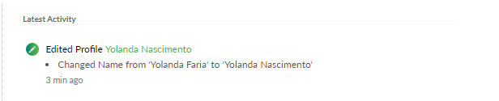
III. Mambu API
Self-Guided Tutorials
Response
7.1 Validation of client updated in sandbox.

Slide 46
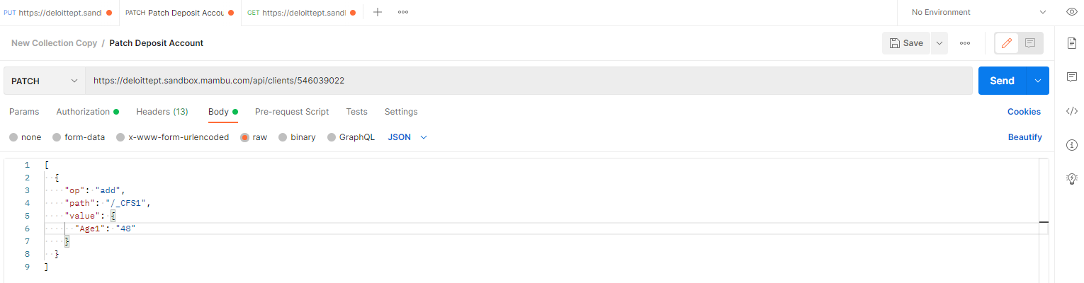
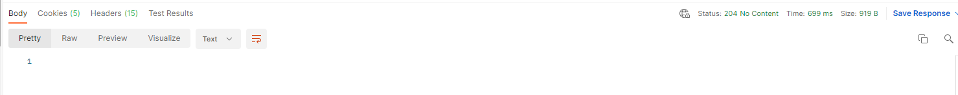
III. Mambu API
Self-Guided Tutorials
8. PATCH Client
Assumptions:
Valid user;
Valid API;
Client id;
Custom field set id.
API related to patch
Note: ID client to update
Request
Body
Response

Slide 47

III. Mambu API
Self-Guided Tutorials
8.1 Validation of client updated in sandbox.

Slide 48
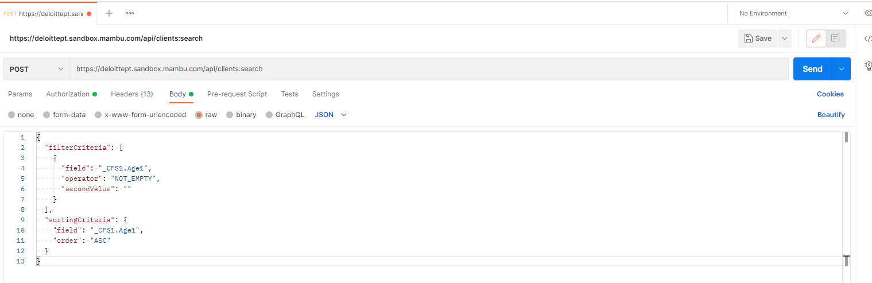
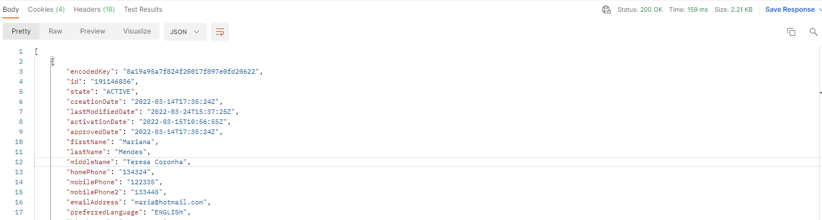
III. Mambu API
Self-Guided Tutorials
9. Search Client
Assumptions:
Valid user;
Valid API;
Custom field set name.
API related to search
Request
Body
Response

